Slide 1
Transformations for Regression Modeling
SDS 291 – Multiple Regression
March 30, 2020

Slide 2
What to Do When Regression Conditions Are Violated
Examples:
Lack of normality in residuals
Patterns in residuals
Heteroscedasticity (nonconstant variance)
Outliers: influential points, large residuals

Slide 3
Data Transformations
Can be used to:
Address nonlinear patterns
Stabilize variance
Remove skewness from residual
Minimize effects of outliers

Slide 4
Common Transformations
For either the response (Y) or predictor (X)...

Slide 5

Example: Planets
Year = length of the “year” for planets
X = distance from the Sun
library(tidyverse)
Planets<-read.csv(url("https://sds291.netlify.com/15/Planets.csv"))
qplot(x=Distance, y=Year, data=Planets)
Planets <- Planets %>%
mutate(newyear=Year^(2/3))
qplot(x=Distance, y=newyear, data=Planets)

Slide 6
Example: Planets
Planets.R
Y = length of the “year” for planets
X = distance from the Sun
Try scatterplots and SLM with
Y vs. X
log(Y) vs. X
Y vs. log(X)
log(Y) vs. log(X)
Note: the default log in R is natural log (ln) or log base e.

Slide 7
Example: Mammal Species (1 of 2)
Y = number of mammal species on an island
X = area of the island
Data on 14 islands in Southeast Asia are stored in SpeciesArea.

Slide 8

Indonesian Map

Slide 9
Example: Mammal Species (2 of 2)
Y = number of mammal species on an island & X = area of the island
Original Form
Logged Both X and Y
logSpecies= 1.625 + 0.235logArea
➔Species = 5.08 · Area^{0.235}
Code in SpeciesArea.R

Slide 10
Why a Log Transformation?
Some relationships are multiplicative (not linear).
Look for:
Strongly right-skewed distributions
Curvature in scatterplot
Increasing variability in scatterplot

Slide 11
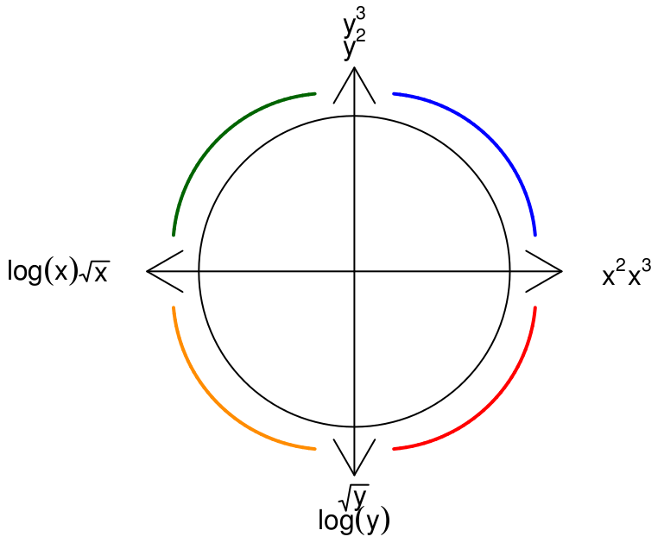
What Kind of Transformation?
Tukey’s Ladder

Slide 12
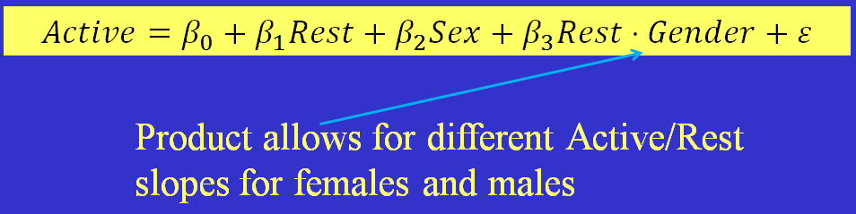
Interaction
Recall:
Interaction: When the relationship between two variables changes depending on a third variable.
Modeling tip: Include a product term to account for interaction.

Slide 13
Example 3.11 in the Text: Fish Weights (1 of 3)
Data: Perch (measurements for 56 fish)
Predictors: Length, Width (in cm)
Response: Weight (in gm)
Fit a two-predictor model with an interaction.

Slide 14
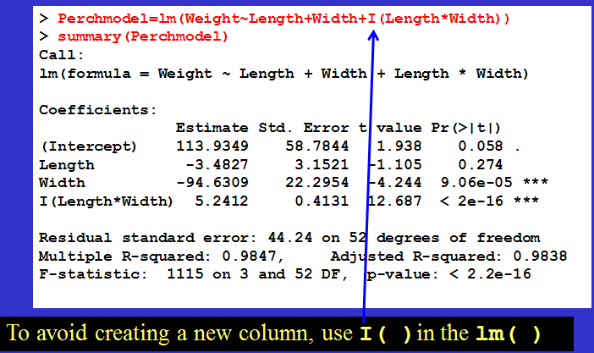
Example 3.11 in the Text: Fish Weights (2 of 3)

Slide 15
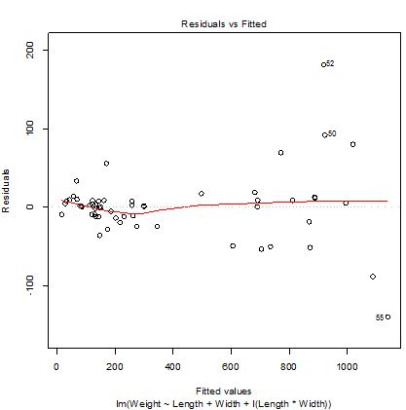
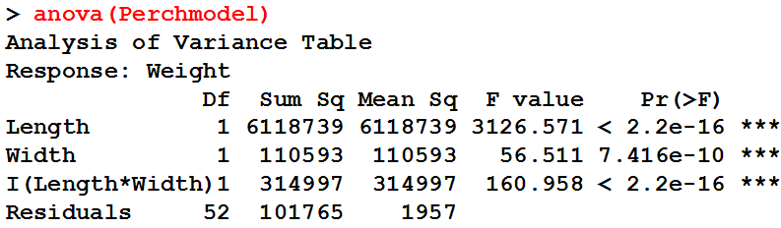
Example 3.11 in the Text: Fish Weights (3 of 3)
All three terms are significant. (But there is a pattern in the residual plot . . . might try log(Weight).)

Slide 16
Example: State SAT Scores
Response variable:
Y =average combined SAT score
Potential predictors:
Takers = % taking the exam
Expend = spend per student ($100’s)
Data file: StateSAT82
Notes:
These are 1982 SAT scores (see B.Powell and L. Steelman, Harvard Education Review 54(4), 389-412 ) and 1981 state expenditure data (Statistical Abstract of the United States 1982-83 (Table No. 251)

Slide 17
Example: State SAT
Y = combined SAT
X = % taking SAT

Slide 18
Polynomial Regression

Slide 19
Polynomial Regression in R
Method #1: Create new columns with powers of the predictor.
library(tidyverse)
StateSAT82 <- StateSAT82 %>%
mutate(Takers_Sq=Takers^2)
quadmod_method1 <- lm(SAT~Takers+Takers_Sq, data=StateSAT82)
To avoid creating a new column:
Method #2: Use I( )in the lm( )
quadmod_method2 <- lm(SAT~Takers+I(Takers^2), data=StateSAT82)
Code in StateSAT.R
Notes:
Without raw=TRUE we get orthogonal polynomials

Slide 20
Quadratic Model for SAT
> quadmod_method2 <- lm(SAT~Takers+I(Takers^2), data=StateSAT82)
> summary(quadmod_method2)
Call:
lm(formula = SAT ~ Takers + I(Takers^2), data = StateSAT82)
Residuals:
Min 1Q Median 3Q Max
-83.015 -16.636 0.783 22.167 55.714
Coefficients:
Estimate Std. Error t value Pr(>|t|)
(Intercept) 1053.13112 9.27372 113.561 < 2e-16 ***
Takers -7.16159 0.89220 -8.027 2.32e-10 ***
I(Takers^2) 0.07102 0.01405 5.055 6.99e-06 ***
---
Signif. codes: 0 ‘***’ 0.001 ‘**’ 0.01 ‘*’ 0.05 ‘.’ 0.1 ‘ ’ 1
Residual standard error: 29.93 on 47 degrees of freedom
Multiple R-squared: 0.8289, Adjusted R-squared: 0.8216
F-statistic: 113.8 on 2 and 47 DF, p-value: < 2.2e-16
Code in StateSAT.R

Slide 21
Plot the Quadratic Fit
Code in StateSAT.R

Slide 22
How to Choose the Polynomial Degree
Use the minimum degree needed to capture the structure of the data
Check the t test for the highest power
(Generally) keep lower powers—even if not “significant”

Slide 23
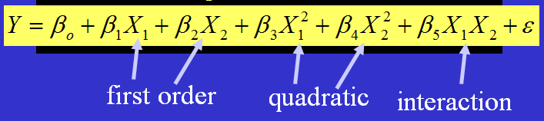
Complete Second-Order Models (1 of 2)
Definition: A complete second-order model for two predictors would be
Example: Try a full second-order model for
Y = SAT using X₁ = Takers and X₂ = Expend

Slide 24
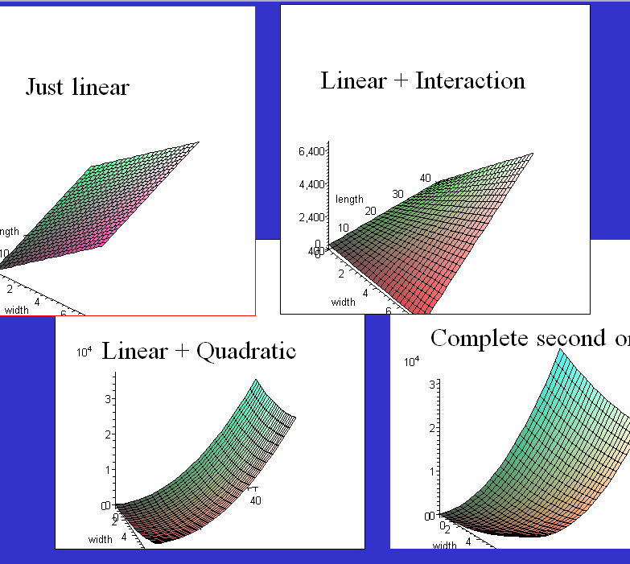
Complete Second-Order Models (2 of 2)
Notes:
Maple: :2Surface.mws

Slide 25
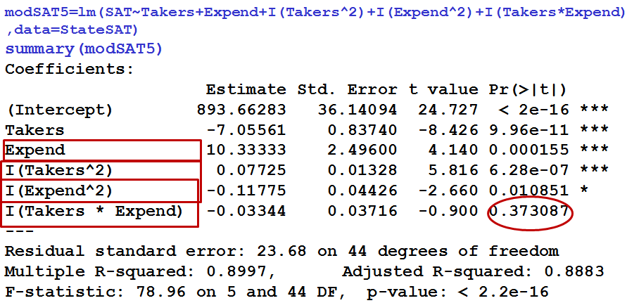
Second-Order Model for State SAT
Do we need the interaction term? No
Do we need both quadratic terms?
Do we need the terms with Expend?
Nested F test (Section 3.6)

